Slide 1
Studying Multiple Growth Phases of E. coli on Minimal Medium with Experiment and Theory
Bachelor Thesis Tobias Pfennig

Slide 2
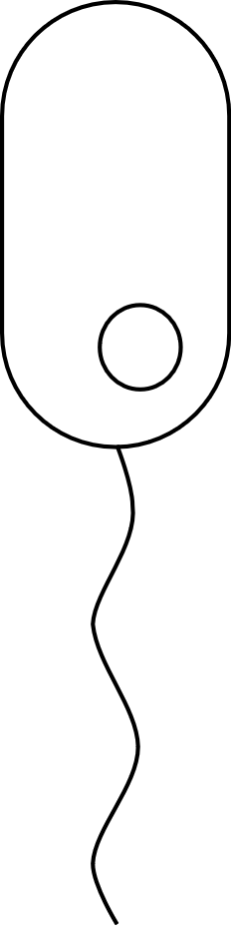
Index
E. coli Strain & Background
Experiments
Measurements
Example Experiments
Points & Phases
Acetate
Monod Modeling
Outlook

Slide 3
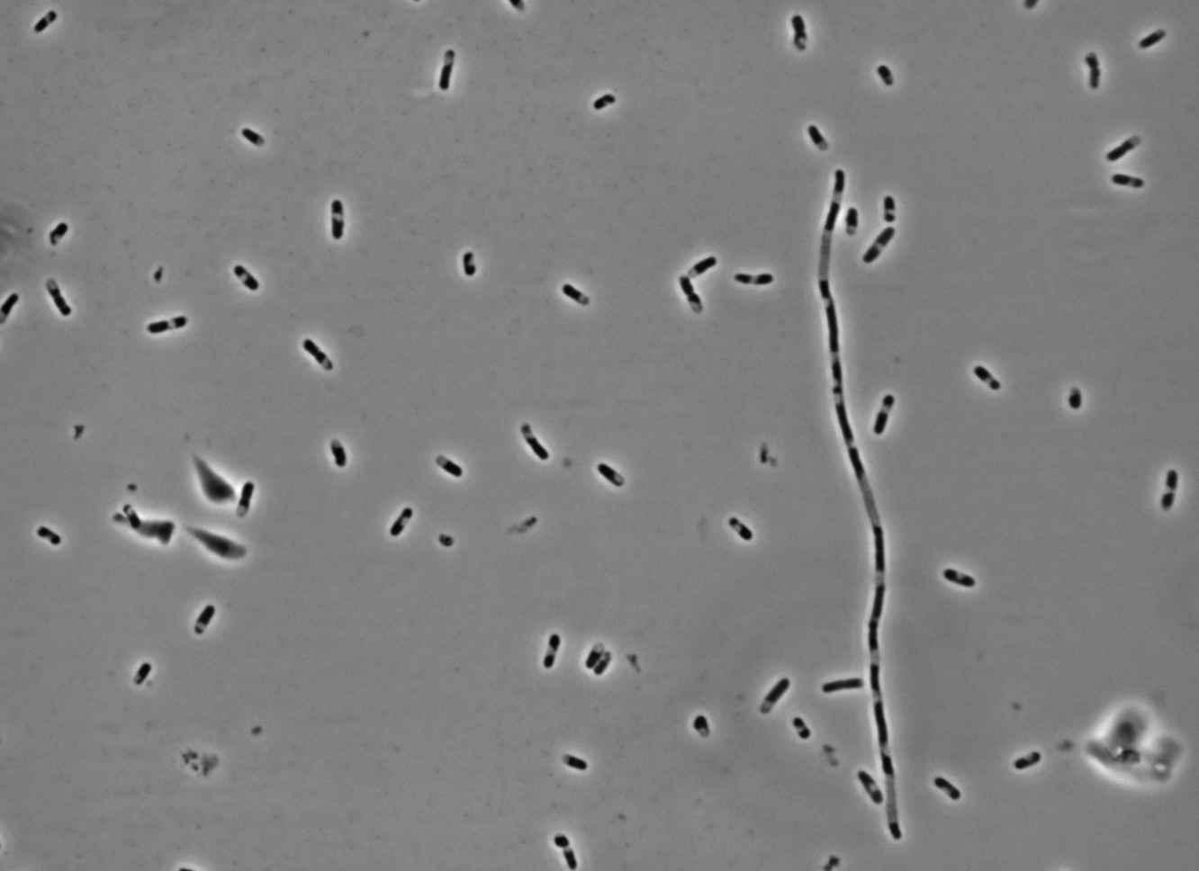
E. Coli Strain
Strain W3110Z1
Widely used for protein production
Low transformation efficiency
Carries Lac and Tet repressors
Coil-Hack
Photo: Jonas Burmester
Notes:
Strain W3110Z1
W3110 used for protein production

Slide 4
Background
Growth on glucose
Graph after Enjalbert et al. (2015)
Notes:
Similarities to other Organisms
Yeast (“Diauxic shift”)
Cancer cells (“Warburg effect”)

Slide 5
Experiments
Glucose or acetate growth
Seven Experiments
Substrate gradients
Cell density gradients
Biomass measurements
Controlled growth with online measurements
48x 1 ml Samples
Notes:
Controlled:
Temperature
Humidity
Shaking -> Gas exchange

Slide 6
Online Optical Measurements
Derived:
Normalized Measurements
Growth rates
Alteration rates
Respiration rates

Slide 7
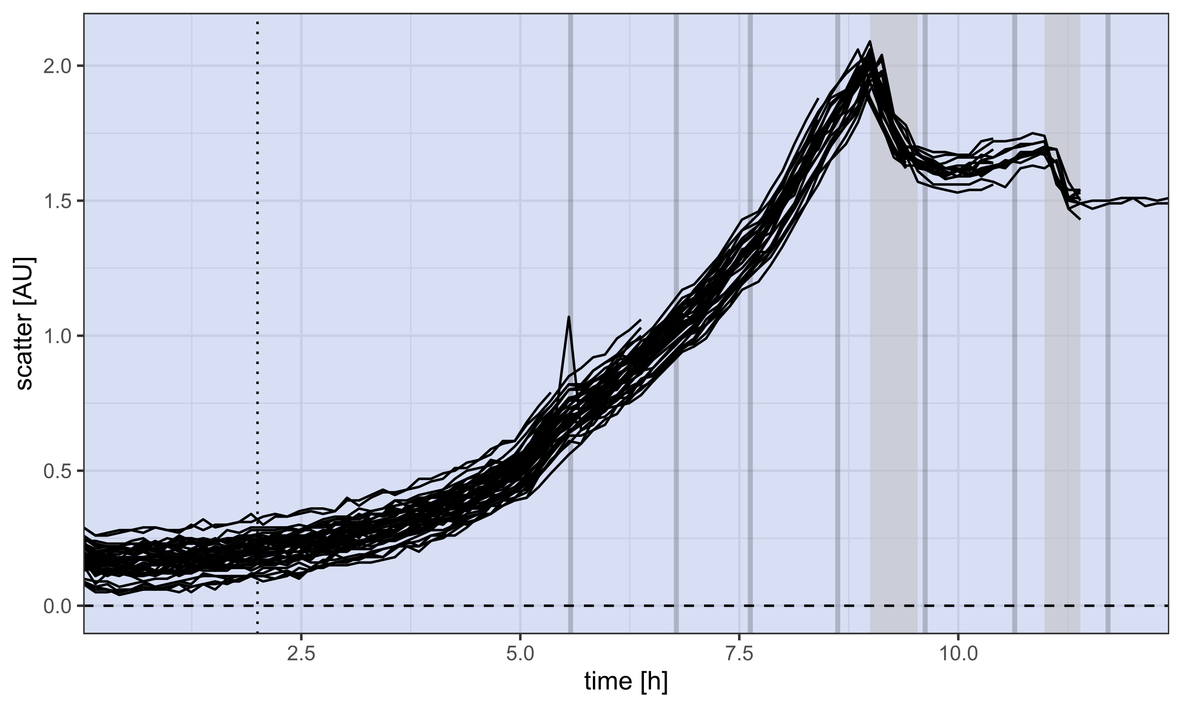
Biomass Measurement
Overview Glucose
Point of Interest
Short time range
Characteristic change in measurements
Phase
Confined by points

Slide 8
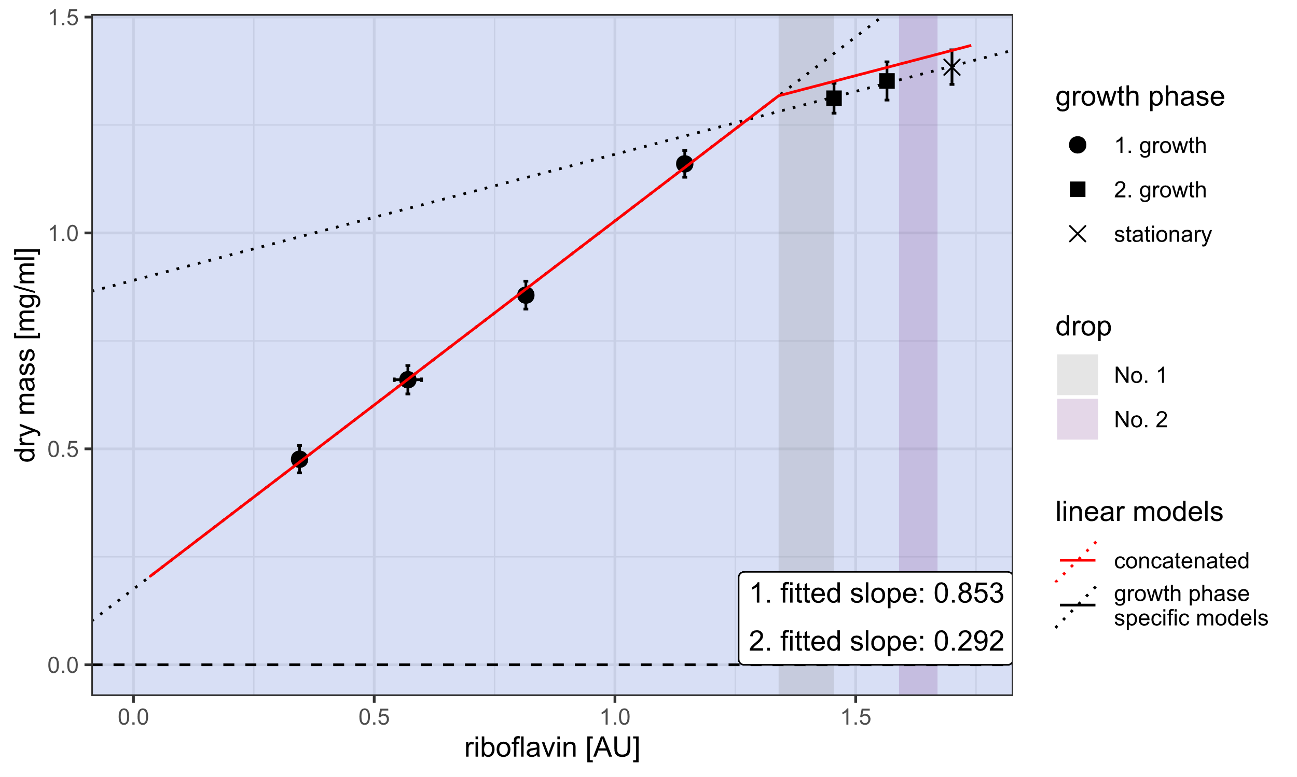
Biomass Estimation
Concatenated Model

Slide 9
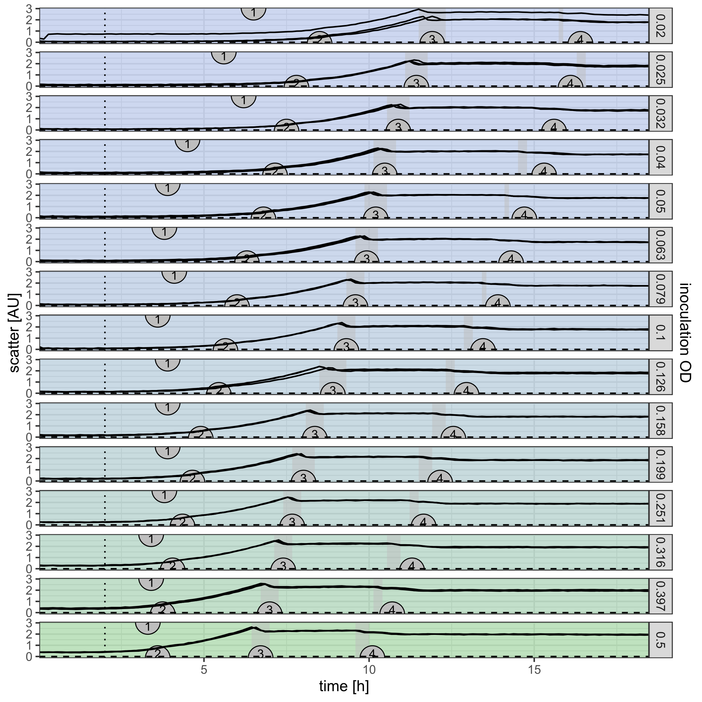
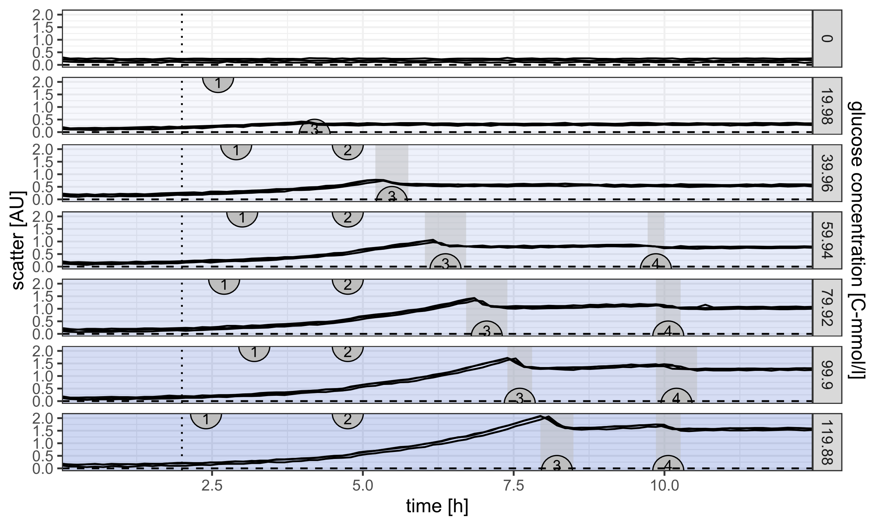
Online Measurements
Example Gradients

Slide 10
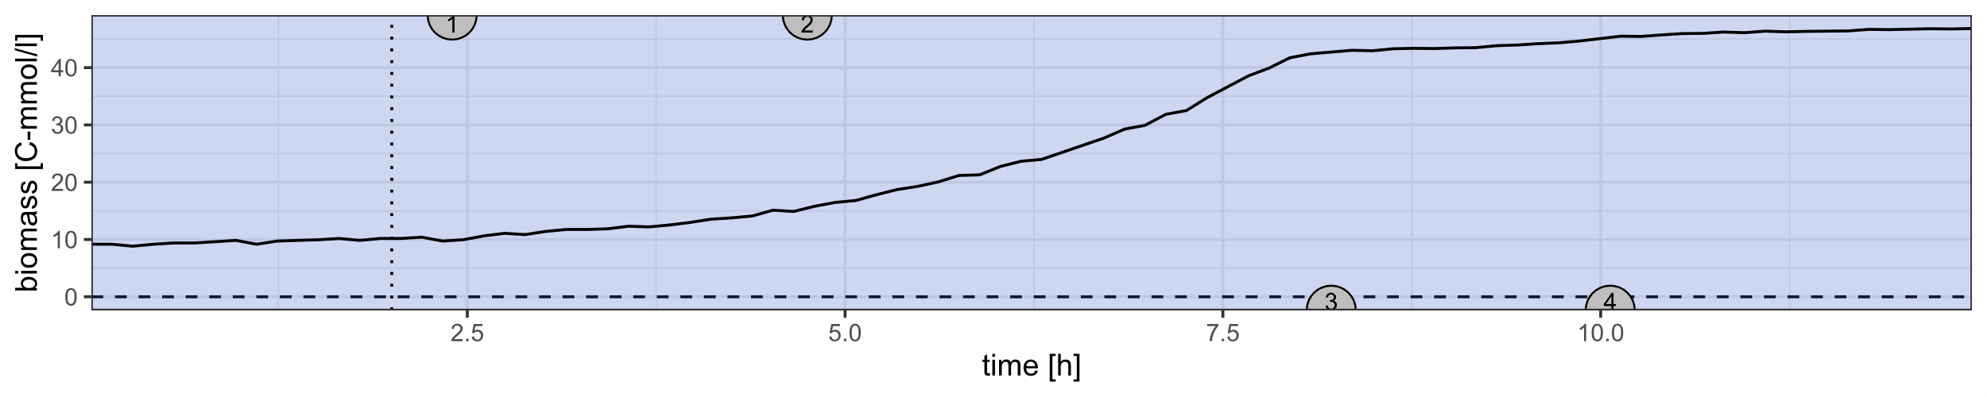
Points & Phases Glucose
1
2
3
4
Lag Phase | Onset Growth | Glucose Growth | Onset Overflow | Overflow Metabolism | Acetate Switch | Lagging Acetate Growth | Onset Stationary | Stationary Phase
● Little growth ● High respiration | ▲ Growth rate | ▲ Growth rate ▲ Norm. NADH | ▼ Respiration | ▲ Respiration ▲ Acidification | ▼ Scatter ▼ Respiration | ▲ Alkalization ● Little growth | ▼ Scatter ● Rates to 0 | ● Stationary Measurements
 | Cell density triggered |  | NADH/NAD⁺ triggered |  | Glucose exhaustion |  | Acetate exhaustion

Slide 11
Summary Glucose
Scatter drops

Slide 12
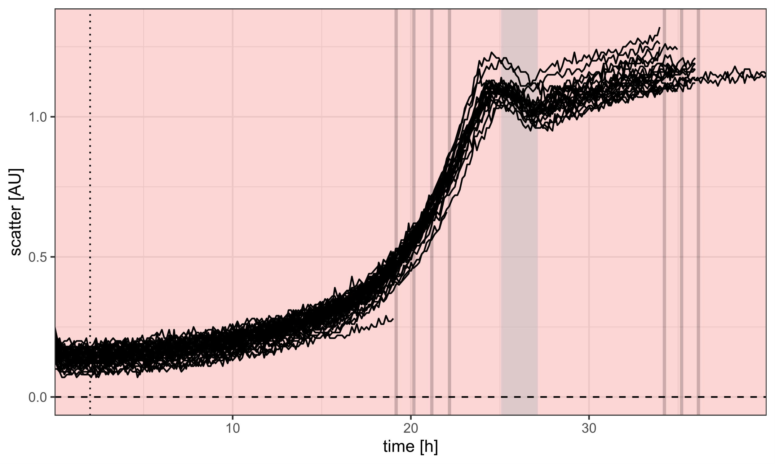
Acetate
Overview

Slide 13
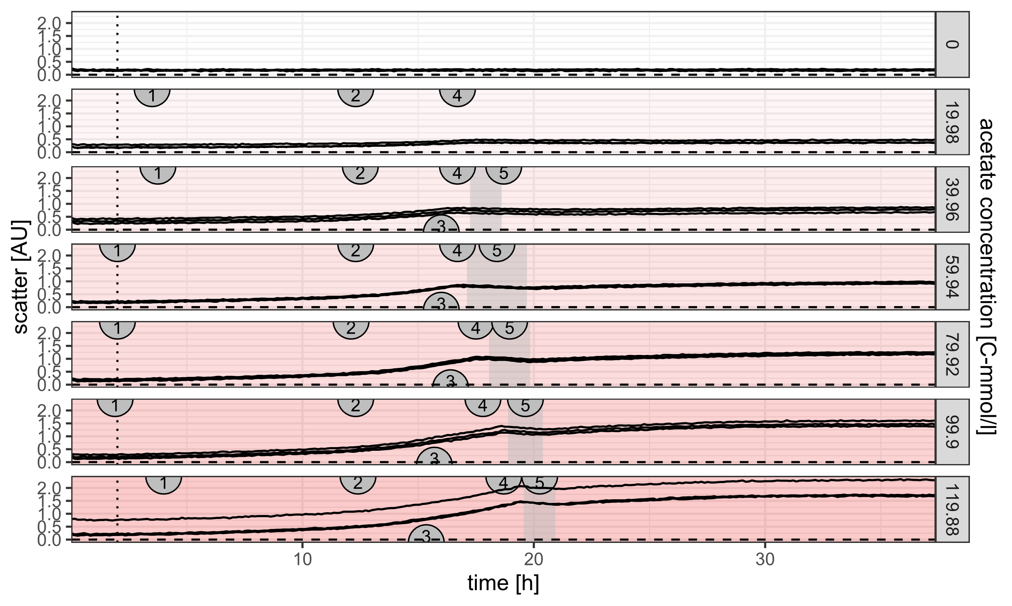
Acetate
Example Gradient

Slide 14
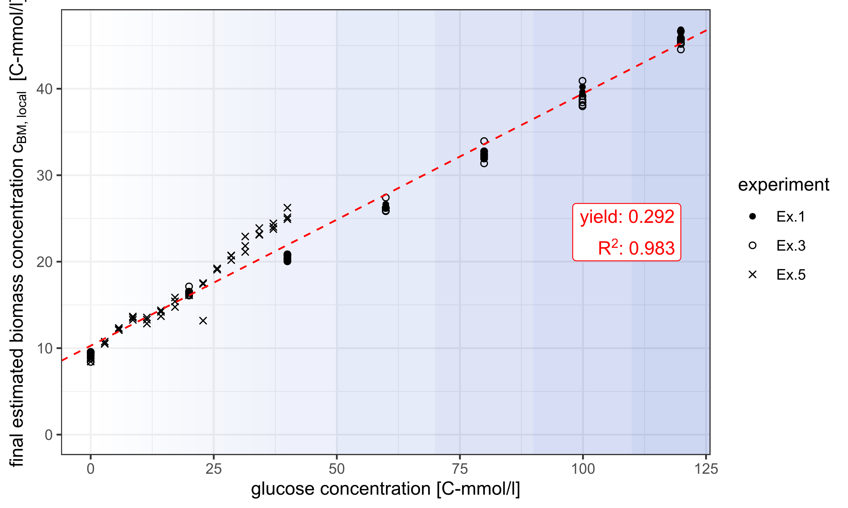
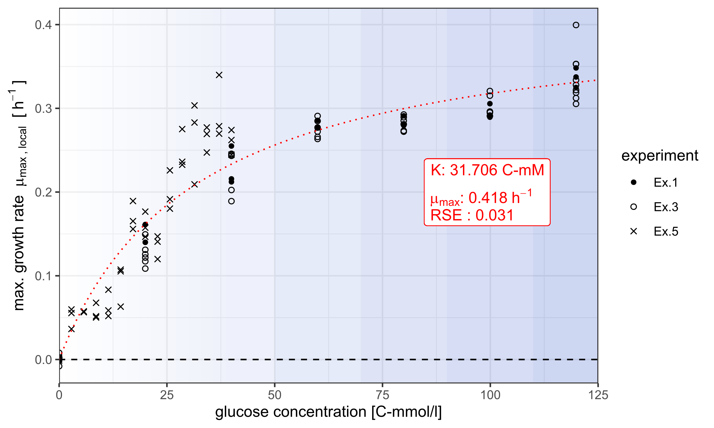
Monod Growth constants
Glucose

Slide 15
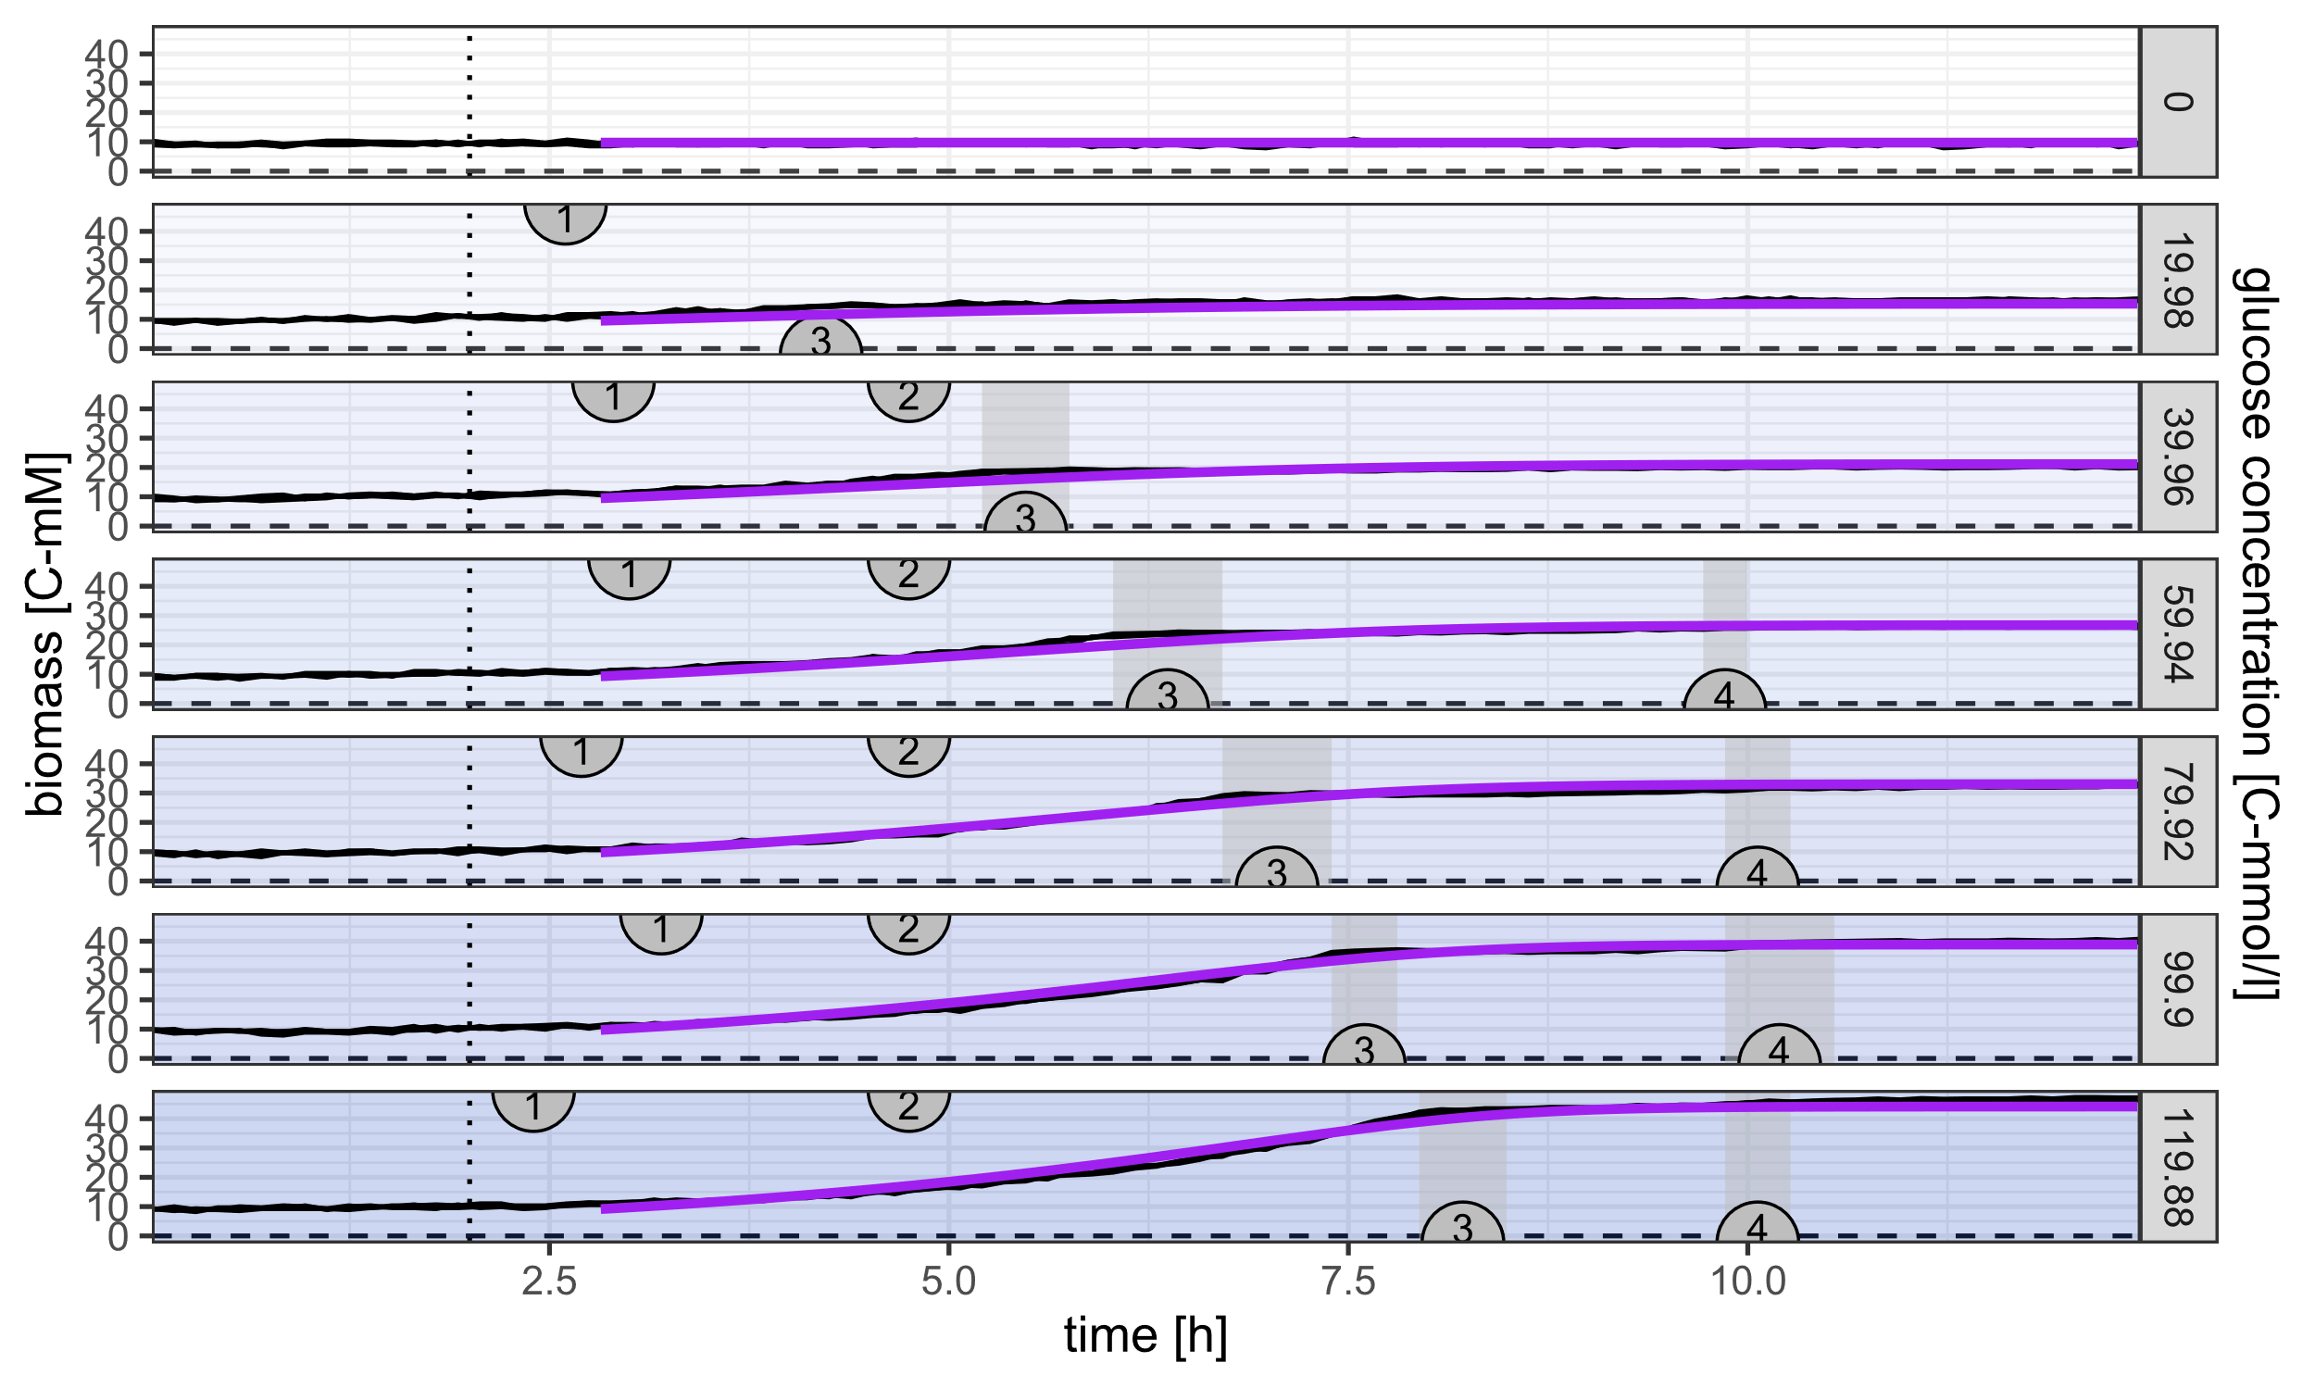
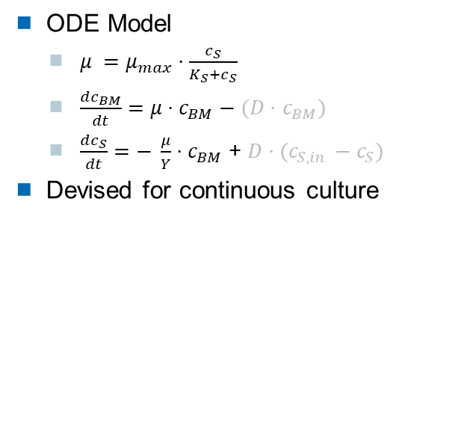
Monod Fit
Glucose
ODE Model
$μ =μ_{max}⋅\frac{c_{S}}{K_{S}+c_{S}}$
$\frac{dc_{BM}}{dt}=μ⋅c_{BM}−(D⋅$ $c_{BM})$
$\frac{dc_{S}}{dt}=− \frac{μ}{Y}⋅c_{BM}$ + $D⋅(c_{S, in }−c_{S})$
Devised for continuous culture

Slide 16
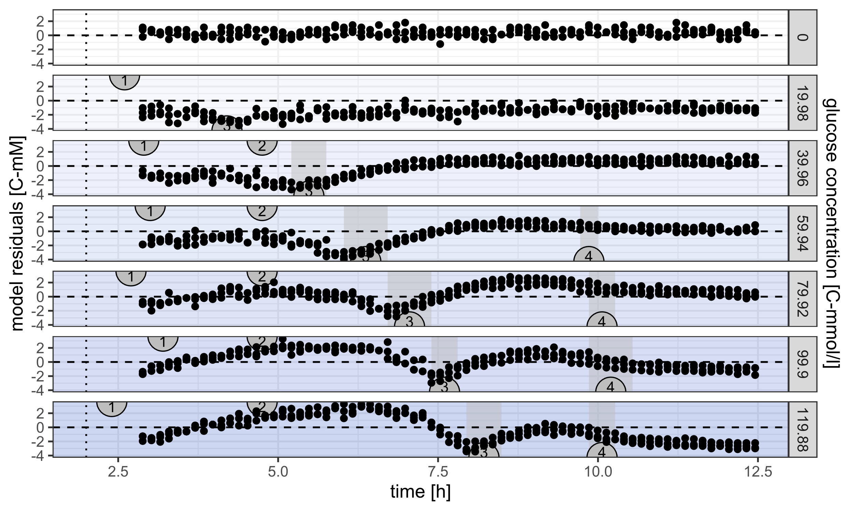
Monod Fit
Residuals
Rough agreement
Doesn‘t reproduce points and phases
Continuous culture: steady state

Slide 17
Outlook
Further Experiments & Models
Offline, time series measurements
Glucose
Acetate
NADH
Glycogen
Repeat acetate experiments
Higher substrate concentrations
More complex ODE model
Combine with Jonas analysis

Slide 18


Thanks for listening
Acknowledgements
Jonas Burmester
Tim Petzel
Nikolaus Thumm
Maximilian Dietsch
Lutz Claus Berwanger
Nima Saadat
Rainer Machne
Alice Pawlowski
Oliver Ebenhöh
Ilka Axmann
And everyone in SynMibi and QTB for having me

Slide 19
References
http://www.expressys.com/main_strains.html
Enjalbert, Brice et al. (2015). “Acetate exposure determines the diauxic behavior of Escherichia coli during the glucose-acetate transition”. In:Journal of Bacteriology197.19, pp. 3173–3181.issn: 10985530.doi:10.1128/JB.00128-15.

